Slide 1

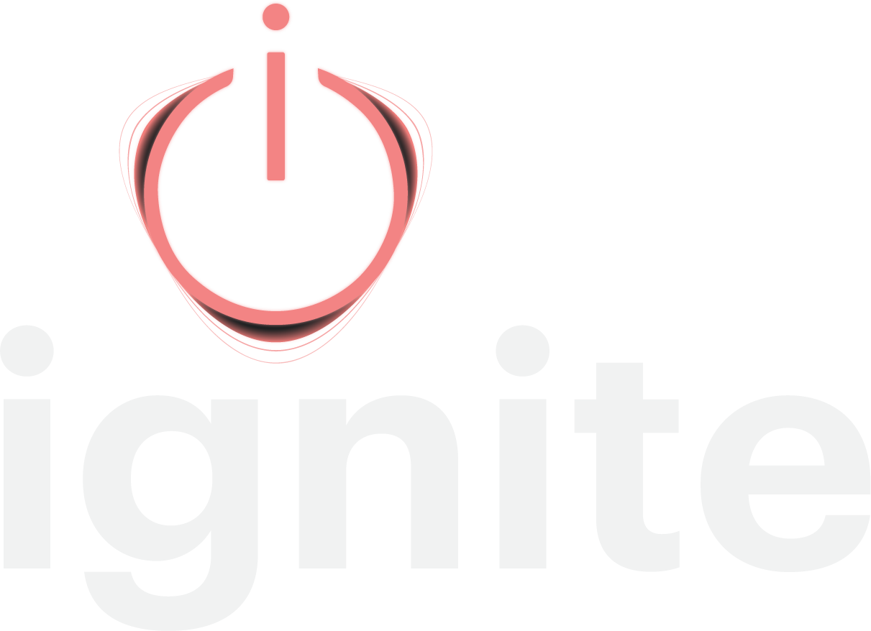
THE AGENTIC PLATFORM FOR REVENUE STRATEGY
Ignite replaces activity
with strategy, and proves
it worked.
Right, or just lucky? Now you'll know.
do less. make it mean more.
THE PROBLEM
Busy isn't a strategy.
Talented teams, good tools, a budget, a forecast, and a 30-60-90 list for every hotel. Then the market outruns the forecast and the year turns into reacting. Nobody dropped the ball. Planning was built for budgets and task lists, so great teams drown in activity, starved for impact.
3 months
at best, from spotting a shift to acting on it. Results take longer.
30-60-90
day task lists in the field, the same as they have always been
15.5 hours
per hotel, at a management group, on a plan that was never used
$1.3M to $2M
estimated missed revenue in one 100-room asset in a tertiary market
WHAT IGNITE DOES
Agentic, because it does the structuring work. Continuously, not once a year.
Strategy
Spots the quake, a shift in demand, a segment, a feeder market or a competitor's move, before it hits your numbers.
Focus
Builds the revenue roadmap and ranks every move by revenue and profit together. Fewer moves. Bigger ones.
Timing
The playbook lands with every hotel's sales, marketing, and revenue people, and stays current as the market shifts.
Proof
Shows the impact of each action, so owners see what your team did, apart from what the market did.
Unlike your RMS, your dashboards, or a once-a-year plan. The RMS sets tonight's rate (Ignite sits above it). Dashboards add reports. The plan retires to a shelf by spring. Ignite hands you decisions.
STRATEGY BETA GROUP
$20,000 per account. Three to five members.
Not investors. Cash for access, not equity for access. Each member commits several properties and defines success in writing, in their own numbers, before day one.
THE CHARTER RATE
20% under list for three years.
After general availability, on every property you bring on, not just the beta ones. Onboarding waived. Does not stack with other multi-year discounts. Offered once, to this first group.
WHAT MEMBERS GET
• Ignite across your committed properties
• A direct hand in the multi-property build
• Your portfolio's patterns in the engine first
• Kate Burda & Company alongside your team
STRAIGHT TALK ON FUSE
Ignite is live. Fuse, the multi-property layer, is not built yet.
We are building it now, with the members who will run it.
MEET THE CORE TEAM
Kate Burda, Founder. Eddie Westerfield, CTO. Recardo Poole, UI/UX. Tristan Carty, Operations.
Kate brings 28+ years in revenue strategy. Four builders, so three to five members, not thirty.
NEXT STEP 45 minutes. Nothing required from your side.
Watch Ignite run on Flying Horse Resort & Club's live data, with their permission,
or on public data from your own market. Somebody else's numbers first, then yours.

